Slide 1
Big Data Analysis on Storm Events in US
Cloud Computing and big data
By Faisal Khan

Slide 2
Content
Introduction
Dataset
Hadoop Streaming
Map and Reduce Code Example
Results
Problems and What’s Next?
Conclusion

Slide 3






Introduction
We used Hadoop Streaming to run the Map and Reduce jobs.
We analyzed the dataset about the storm events from 2012 to 2016.
Map and Reduce jobs were coded in Python.
Graphs and Charts were plotted using Excel.

Slide 4
Dataset
Data Source
From http://data.gov The climate data
Link https://www1.ncdc.noaa.gov/pub/data/swdi/stormevents/csvfiles/
Dataset contents:
It contains the below storm events details:
YEAR(2016), EPISODE_ID(108769) (denote storm episode),
STATE(Connecticut), CZ_NAME(HARTFORD),
MONTH_NAME(January), EVENT_TYPE(Heavy Rain),
BEGIN_DATE_TIME(7/15/2016 17:15), END_DATE_TIME(7/15/2016 17:15)

Slide 5
Dataset
What information we gathered?
1) Which state had the most storm events?
2) How many events happened in each month in a state?
3) Which type of events happened most?
4) What was the total duration time the storm events for a year in a state?

Slide 6
Hadoop Streaming
What is Hadoop streaming?
A utility that allows you to create and run Map/Reduce jobs with any executable or script as the mapper and/or the reducer.
Languages like C, C++, Python and Shell
Why did we use Hadoop streaming?
We wanted to use Python to do the Map and Reduce jobs.
How to use Hadoop streaming?
Locate the Hadoop-streaming.jar and run the command

Slide 7
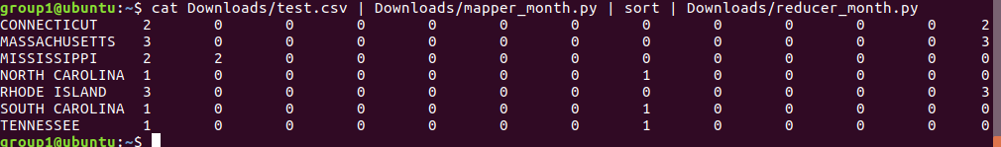
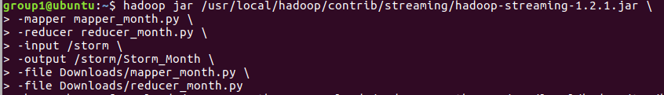
Map and Reduce Example
Test Sample output:
Streaming Commands:

Slide 8
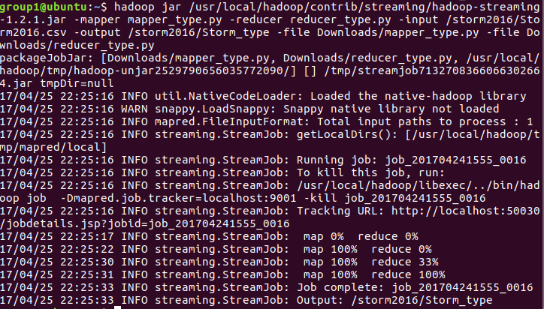
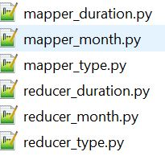
Map and Reduce Example
Mapper and Reducer at Work: Our Map and Reduce Codes

Slide 9
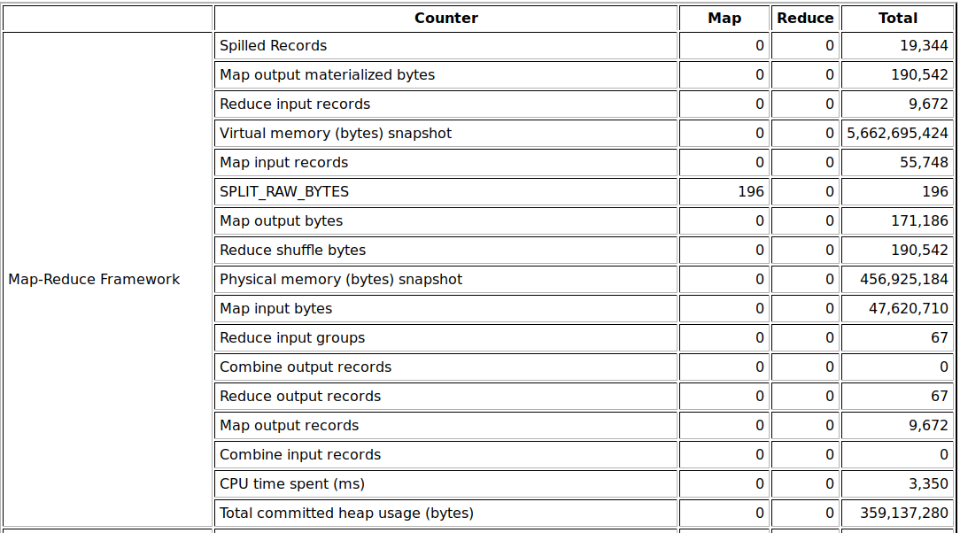
Map and Reduce Example
Map input records | 55,748
Map output records | 9,672
Reduce input records | 9,672
Reduce output records | 67

Slide 10
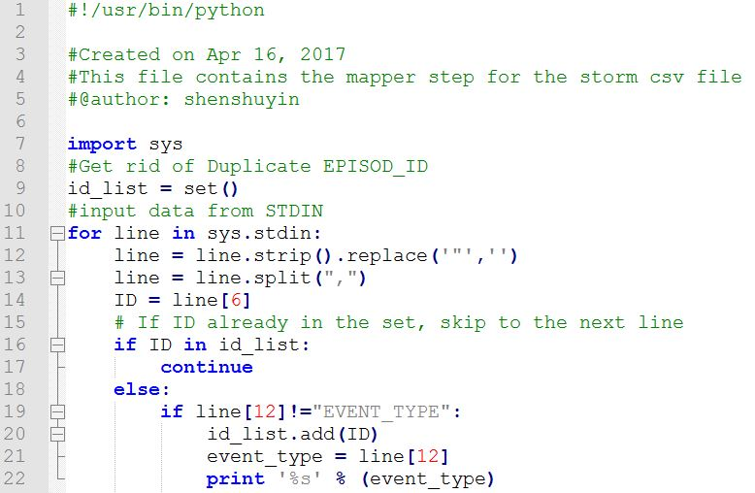
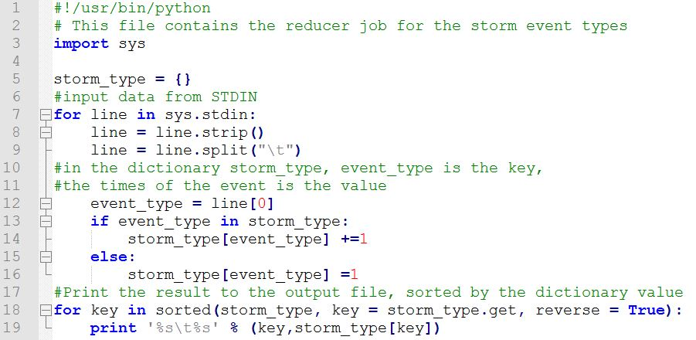
Map and Reduce Example
Mapper program
Reducer program

Slide 11
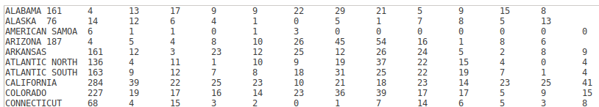
Results
Storm events total for each states (JAN-DEC):

Slide 12
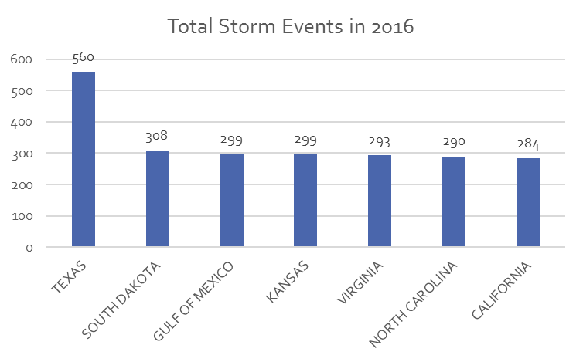
Results
Top 7 States for the most storm occurrences:

Slide 13
Results Comparison (2015-2016)

Slide 14
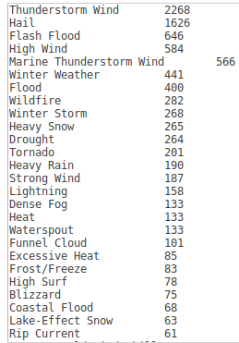
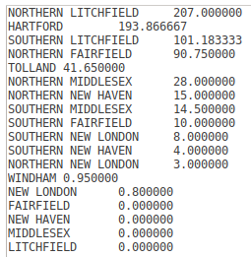
Result
Storm Types Job
Storm Duration Job

Slide 15
Result

Slide 16
Result

Slide 17
Problems And What’s Next?
When we were testing the duration job, we got output for ‘400 Days’, which was way over a year.
We rechecked the datasets and found that, every row had an EPISODE_ID to identify a storm episode, and EVENT_ID to identify an event. There were records having the same EPISODE_ID, but different EVENT_ID.
We then filtered the dataset in the mapper job and got rid of the duplicate EPISODE_IDs.

Slide 18
Problems And What’s Next?
Analyze more year data and try to make some prediction.
For e.g.:
What type of climate changes are occurring?
Is Global Warming affecting our weather?
Is the world getting WARMER?!!

Slide 19
Conclusion
In Hadoop, there is a Java program called Hadoop streaming-jar. This program internally reads (stdin) and prints out (stdout) line by line. Therefore, Python or other coding language can read each line as a string and parse it by using functions like strip and split(",").
Get to know of your dataset:
We need to know the attribute and detail about the data. Know what we can get from the data before we do the MapReduce Jobs or think about analyzing the data

Slide 20
Thank you

